Slide 1

REPORT ON UWL-NCL
COLLABORATION:
CHINESE RARE BOOKS DIGITAL PROJECT
Zhijia Shen
University of Washington Libraries
March 2013, San Diego

Slide 2
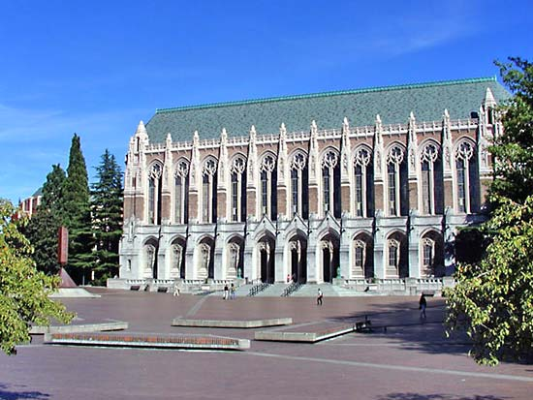
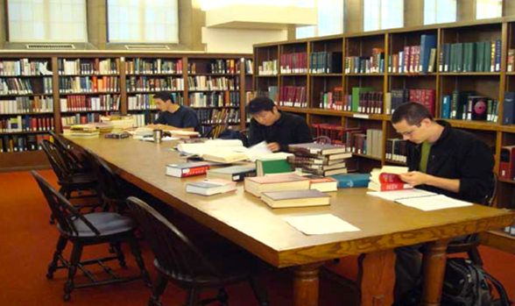

University Libraries
Large public research library
One library of 16 branches serving three campuses of a total of 45,000 students
2004 Winner of ACRL Excellence in Academic Libraries Award
UW EAL- Started in 1937 with first official funding
  Total holding: 640,383 vols
  Chinese: 283,822
  Japanese: 154,020
  Korean: 105,388

Slide 3
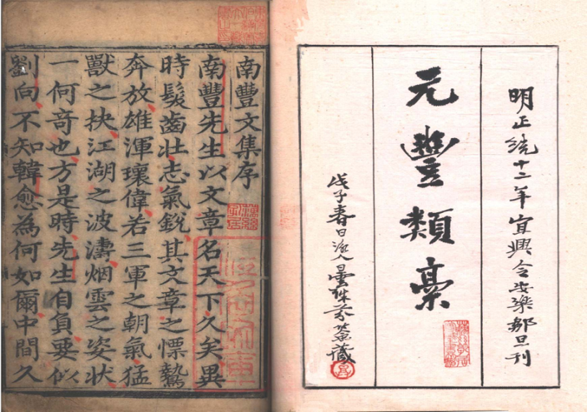
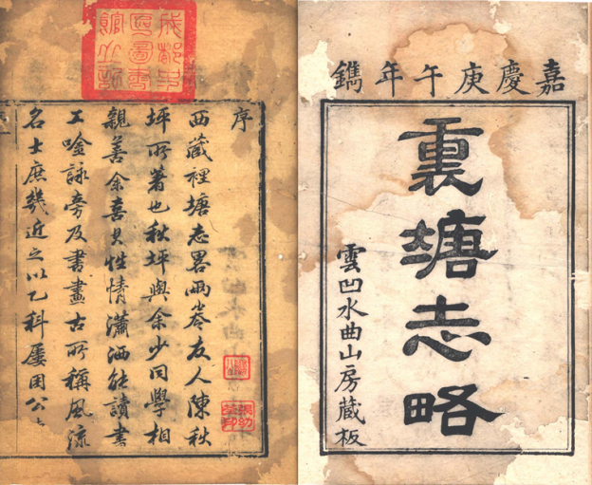

Highlights of UW Chinese Rare Books
138 books printed in the Ming Dynasty (1368-1644)
Joseph F. Rock collection of 830 local gazetteers of South West China
Works of Qian Qianyi (a late Ming Dynasty poet- historian, 1582-1664)
Helmut Wilhelm collection of 1300 titles, of which more than 30 Ming editions, a few hundreds of rare Qing editions

Slide 4
Previous UW Chinese Rare Books Projects & publications
1991 DOE funded cataloging project completed over 3000 cataloging of Qing literary works and local gazetteers
Wang Jue. “Rare works by Qian Qianyi and other Qing Dynasty Rare books of poetry and literature. Bulletin of NCL. V. 25, no. 2.
A descriptive catalog of the Ming editions in the Far Eastern Library of the University of Washington.（华盛顿大学远东图书馆藏明版书录）compiled by Chik-Fong Lee (李直方). San Francisco: Chinese Materials Center, Inc, 1975.
Catalog of the official gazetteers of China in the University of Washington. Compiled by Joseph Dzen-His Lowe. Zug, Switzerland: Inter Documentation Co. [1966]

Slide 5
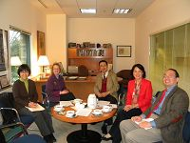
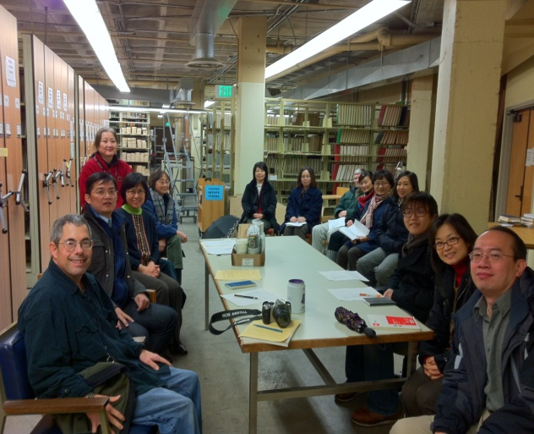
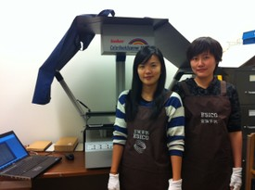

UW-NCL Agreement and Collaboration
UW EAL
E-Service
NCL
Notes:
UW – NCL Chinese Rare Book Project was launched in 2010 when an agreement was signed between the two institutions in Nov. 2009. The Agreement established the terms and conditions under which UWL
and NCL will cooperate to facilitate the digitization and computer-readable description of
selected Chinese rare book materials from the collections of the UWL. These
materials will be made available to users on the NCL web site and on the
UWL web site. Under this Agreement, the focus will be on digitization of selected East Asia Library rare books that NCL does not have, both by title and by edition.
國國家圖書館與美國華盛頓大學圖書館達成協議如下： (The agreement addresses the following: )
一、合作時間：2010年1月1日至2012年12月31日止。 (Timeline of the cooperation: January 1, 2010 – Dec. 31, 2012.)
二、合作範圍：美國華盛頓大學圖書館館藏中文善本古籍數位化分期進行：第一階段掃描館藏互不重複者，第二階段繼續掃描兩館館藏皆有相同題名但版本不同者，第三階段掃描兩館缺卷或殘本的善本古籍。2010年預計數位掃描古籍文獻80,000影幅。 (Scope of this digital project: Chinese rare books held at UWL digitization schedule: 1st period: scanning the titles that are not duplicated by NCL collections; 2nd Period: scanning the duplicates titles but different editions 3rd Period: scan missing volumes or missing pages of each other’s collections. Estimated scanning for 2010 will be 80,000 images)
三、合作分工暨作業方式 (Division of responsibilities in the cooperation):
1.美國華盛頓大學圖書館提供其館藏中文善本古籍原件暨掃描作業所需之獨立空間、網路傳輸設備；國家圖書館提供掃描作業設備及掃描作業人員，在美國華盛頓大學圖書館提供之場所進行掃描作業。
UWL will provide the rare Chinese books for scanning, office space for the scanning work, Internet equipment; NCL will provide scanning equipment and technicians. Scanning work will be done at the UWL.
2.進行掃描之書目由國家圖書館進行目錄鍵檔；鍵檔作業程序遵循詮釋資料（metadata）鍵檔格式。掃描原始檔案為1：1比例跨頁掃描、24-bit影像、300dpi之彩色TIFF檔。
NCL will develop catalog for the books scanned according to metadata format. The original scanning will be 1:1 cross two pageas, and 24-bit images, 300pdi color TIFF file.
3.掃描後之原始檔案，由國家圖書館製作300dpi TIFF之檔案貳套，並由國家圖書館再轉製為72dpi JPEG檔案貳套，分別由雙方持有各壹套。
The original files after scanning will be made two copies of 300dpi TIFF file, and then transferred into 72dpi JPEG file two copies for both party to hold one copy each.
4.該數位化檔案，可於國家圖書館網站上提供公眾利用檢索。
Digitized files will be loaded onto the website of NCL for public use.

Slide 6

Scope of the Project:
Timeline: January 2010 –December 2012
Materials: UW Chinese rare books unique to NCL (dated before 1796 and rare editions between 1796 and 1911)
3 Phases:
  Phase I: titles not held by NCL
  Phase II: titles held by NCL but different editions
  Phase III: missing volumes and pages of NCL.
Estimated around 80k images each phase; and a total of 350 titles to be digitized by the project.

Slide 7
Final Product & Access
A set of standards was developed and agreed on by UWL and NCL
Scanned files are made into two copies of 300dpi TIFF file, and then transferred into 72dpi JPEG file; one copy for each party.
Scanned files are to be loaded to websites of both parties for public use; NCL to develops metadata to share with UWL

Slide 8
Division of responsibilities
UWL: prepare and provide a list of rare Chinese books with detailed cataloging information for metadata, from which EAL librarian selects in consultation with NCL rare-book librarian for scanning,
UWL provides office space, Internet connection and equipment
NCL: Provides scanning equipment and technicians through E-Service Information Inc.
Scanning work is done at the EAL of UWL.

Slide 9
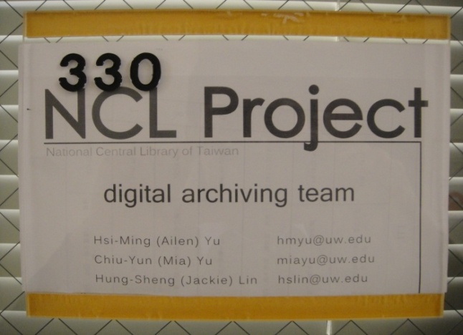
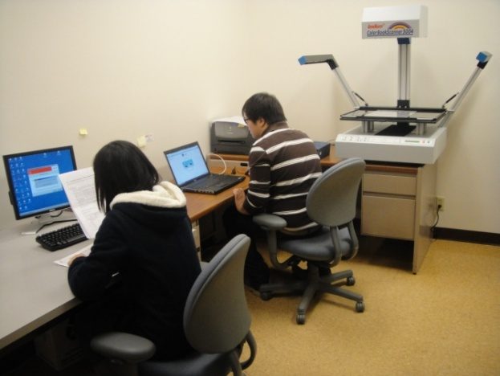
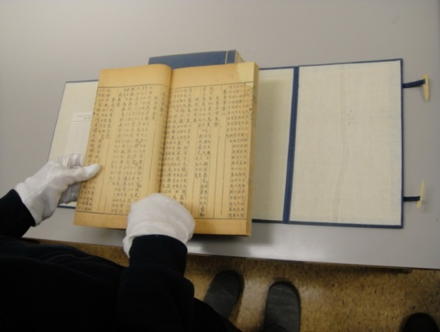
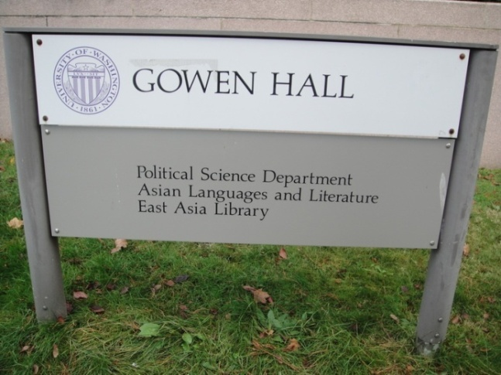
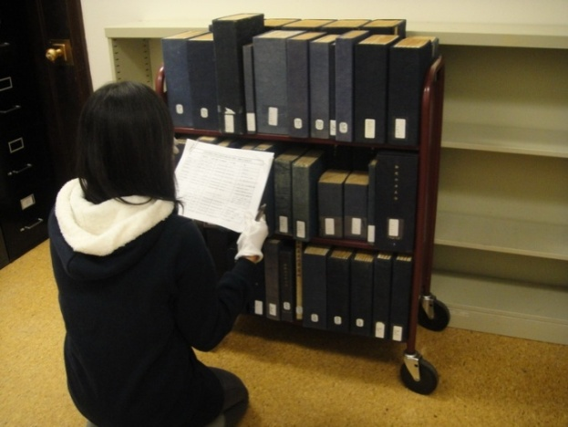
Working environment @UW EAL
Project Office
Team at work
Evaluate book conditions
East Asia Library
Checking in books

Slide 10
Project Workflow
Checking out Rare Books from EAL for Processing
Recording Conditions of Rare Books
Scanning
Error
First Proofing – on site
(Examining the Quality of Scanned Images Page by Page)
Correct
Error
Post-Production & Second Proofing – E-Service Taipei
Correct
Error
Third Proofing & Final Check- NCL Taipei
Correct
Storage & Back-up & Product Delivery

Slide 11
Workflow @UW
Confirming Book Selection with EAL Librarian
Checking out Rare Books from Librarian
Double Checking & count Rare Books against List
Recording Conditions of Rare Books in Daily Log &
Creating Index Tables for File Name/Book Number
Scanning
First Proofing
Send Files off to Taiwan for 2nd Proofing

Slide 12
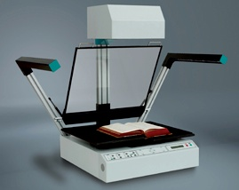
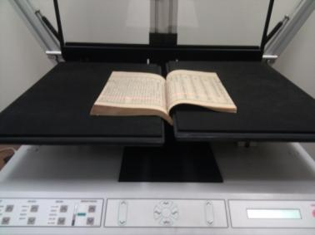
Equipment
Book Scanner 5004C
Features:
High precision LINOS (Rodenstock) scan lens
High resolution CCD image sensors
Mobile light strip with high power white LEDs
Integrated motor-driven book cradle
Originals up to DIN A2 Plus (16.53 inches x 24.80 inches)
Telescopic rail system for adjustment of book cradle plates
Wood surface for the safe scanning of delicate originals
Scanning resolution: True 400 x 600 dpi on documents of
Color depth: 36 bit internal, 24 bit external

Slide 13

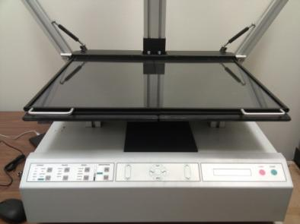
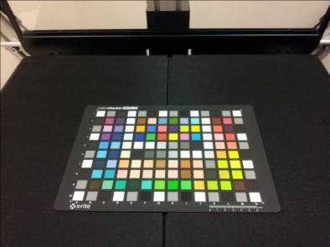
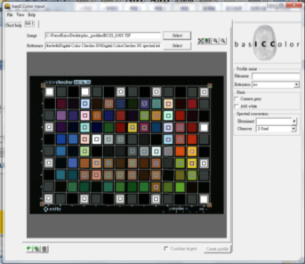
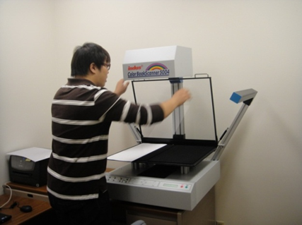
Equipment & Daily Preparation
INDUS 5004C
Maintain
ICC
Clean
Cleaning scanner glass
Device calibration
Construction of ICC profile
Pre-scan & set scanning parameters

Slide 14
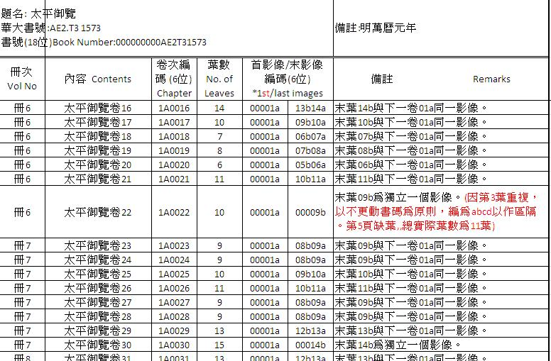
Reports
Daily log
Weekly report
Report for each phase
Final Report
驗收人員： 日誌頁次：100（年）-11（月）-18（日）-1（頁）
紀錄人員： 簽收日期：民100年 月 日
書 號 | 冊數 | 掃描頁數 | 備註（資料原件字跡不清、殘破、漫渙、蟲蛀……等影響掃描品質的情形需紀錄檔案編碼及現象）
000000000000001333 | 5冊 | 300 | OK
xxxxxxxxxxxxxxxxxx | 10冊 |  | 例： 紙張薄脆碎裂，需修裱。
xxxxxxxxxxxxxxxxxx | 8冊 |  | 例：穿線斷裂，需重新縫線。

Slide 15
Reports
當週工作記錄
DATE | 實際掃描葉數 | 其他事項
10/01 | 827 | *唱經堂才子書彙稿-此套書紙張破損嚴重
10/02 | 600 | *契丹國志-原註記為27冊,修正為4冊
10/03 | 797 | *前後漢紀-多葉紙張不完整
10/04 | 871 | *廣雅疏證-因單冊上達百葉,編碼原則調整為8位數
10/05 | 627 | *王臨川文集 *此套書酸化嚴重,裝線鬆脫;多葉一分離為二
掃描總計 | 3,722 | 本週預計達成葉數4,000葉，實際完成3,722葉，當週達成率93.05% 目前累計影幅數為78,383葉，總達成率為92.22%。 專案累計進度 5月份已完成：10套書， 98冊，6,526影幅數。 6月份已完成：25套書，256冊，17,118影幅數。 7月份已完成：32套書，283冊，17,076影幅數。 8月份已完成：24套書，251冊，18,572影幅數。 9月份已完成：18套書，222冊，15,369影幅數。 (10月份目前已完成：5套書，74冊，3,722影幅數。) 截至目前為止，共計已完成115套書，1,182冊，78,383影幅數。 UW_1001_1005_WEEKLY_REPORT UW_1001_1005_scan_REPORT
Weekly report

Slide 16
UW 3 Phases Completed
Oct 2010-Nov. 2012
Phase1
128 titles
73,102 images
Phase2
129 titles
78,049 images
Phase3
125 titles
85,273 images
Total completed:
382 titles, 3,483 volumes, 236,424 images

Slide 17
UWL Plan for Access: Hathi Trust
Load these e-books onto Hathi Trust to provide broad access
Providing links to OCLC records for searching and access

Slide 18
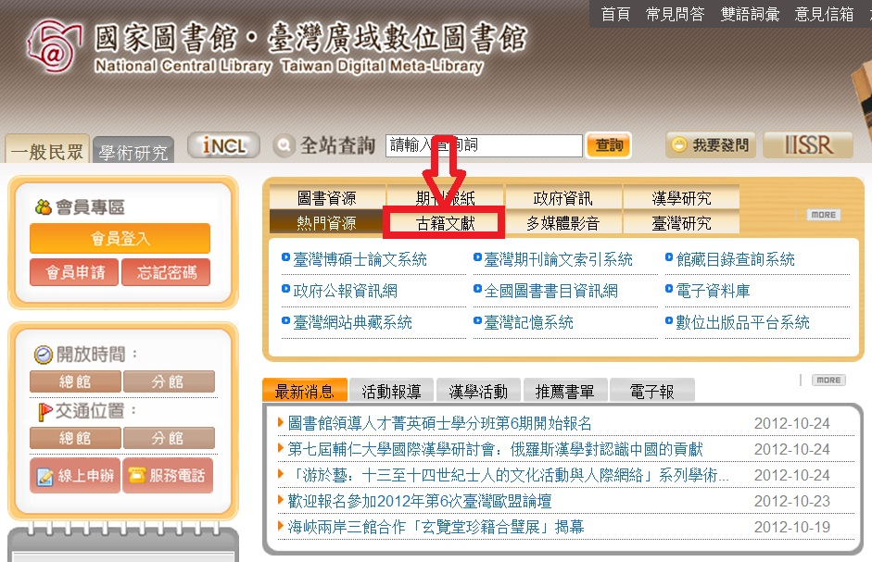
Acccess: NCL Rare Books Search Syetem
臺灣中央圖書館NCL
http://www.ncl.edu.tw/mp.asp?mp=2

Slide 19
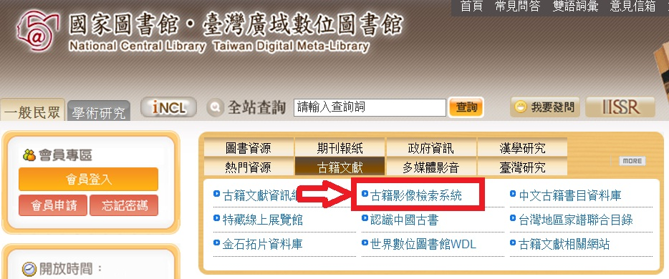
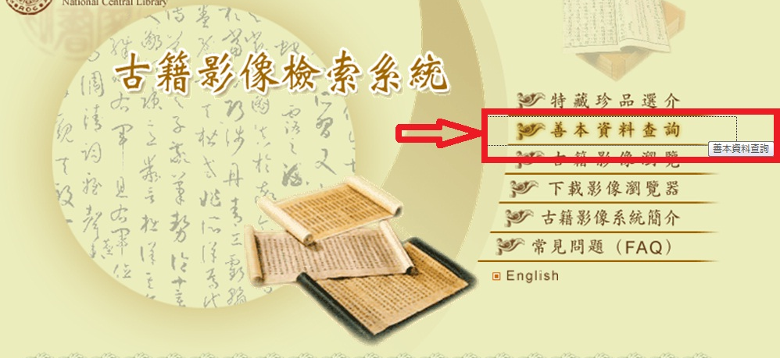
Access
古籍影像檢索系統
善本資料查詢

Slide 20
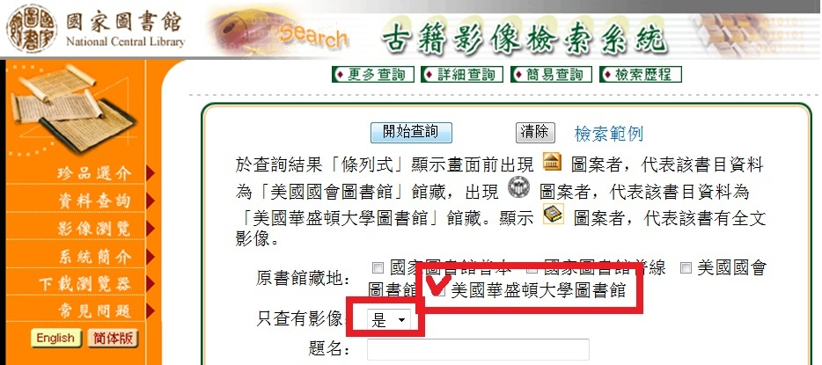
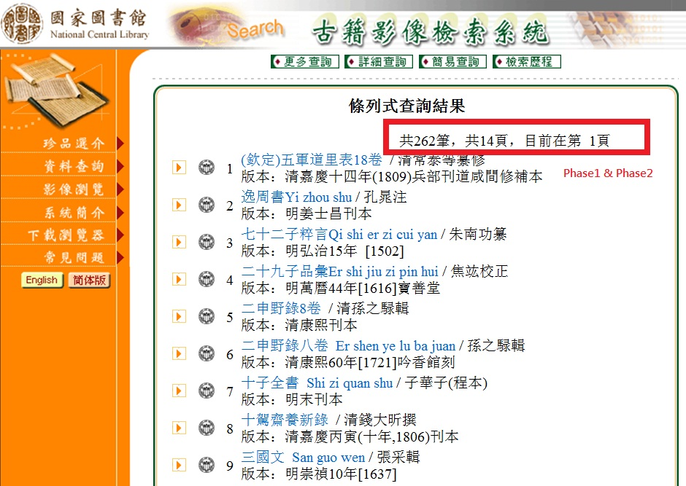
Access
華盛頓大學圖書館
查詢影像檔
Currently 262 titles
(from Phase1&Phase2)

Slide 21
UPDATES FROM NCL

Slide 22
NCL rare book digital resources (as of Dec. 2012)
International collaborations:
LC rare books: 2025 titles, 1,032,407 images
UW rare books: 382 titles, 236,424 images
UCB rare books: 294 titles, 230,739 images
NCL’s:
Rare books: 7,715 titles, 3,969,832 images;
Rubbings: 4,081 titles, 19,301 images;
Dunghuang manuscripts: 201 titles, 2,485 images

Slide 23
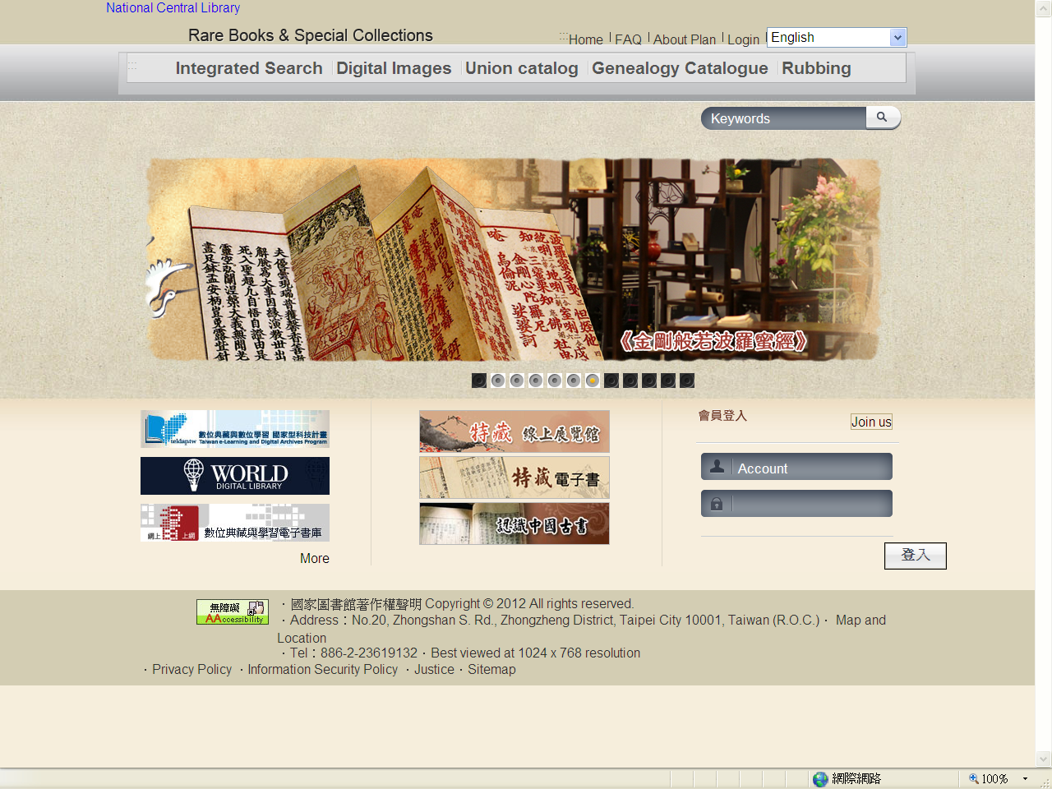
NCL’s Rare Books Images Search System will announce a new version in April! (http://rbook2.ncl.edu.tw/)
Notes:
open management software, water marking, integrated search,…

Slide 24
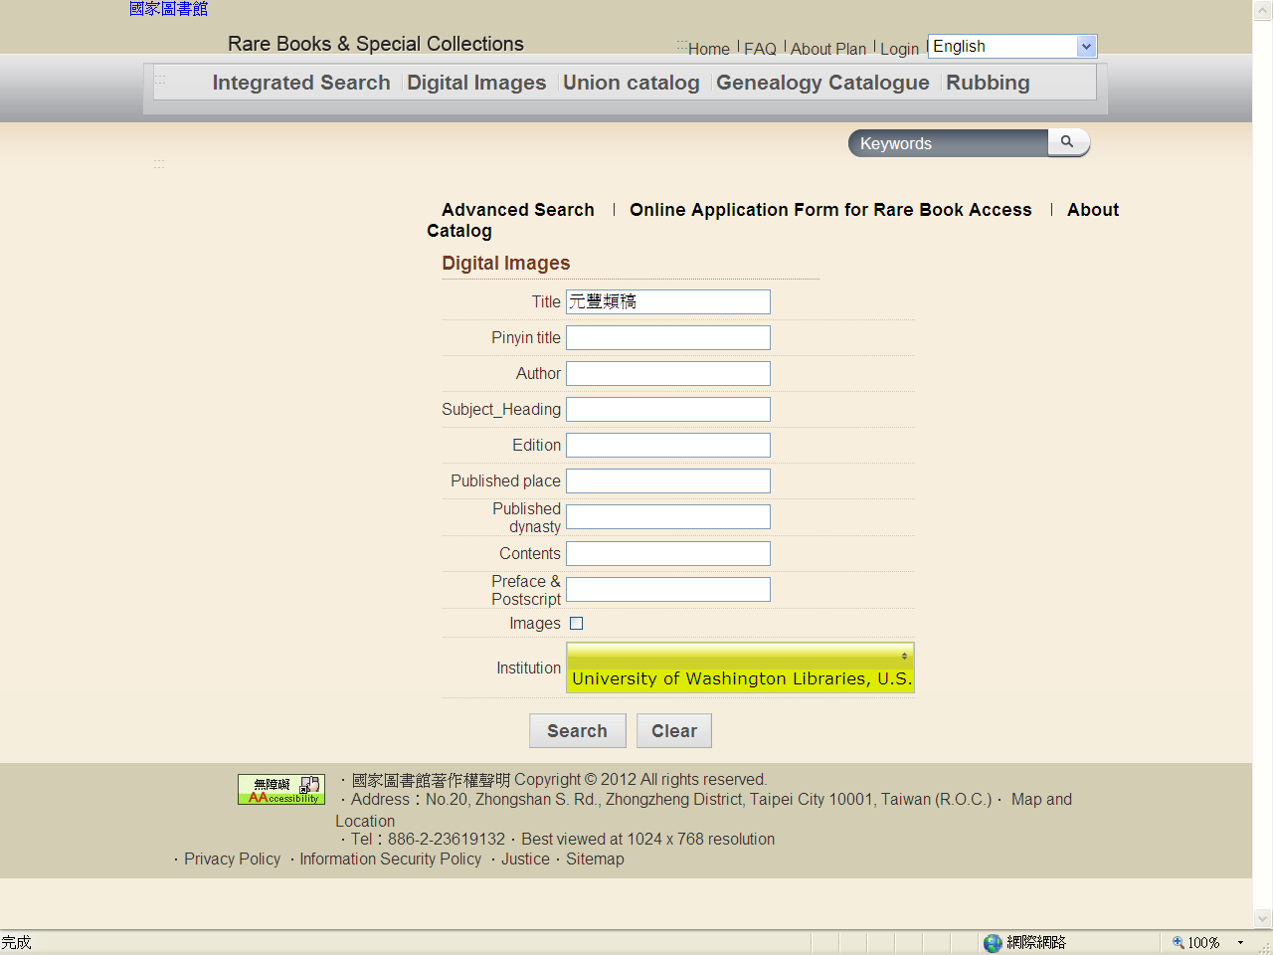
New Interface

Slide 25
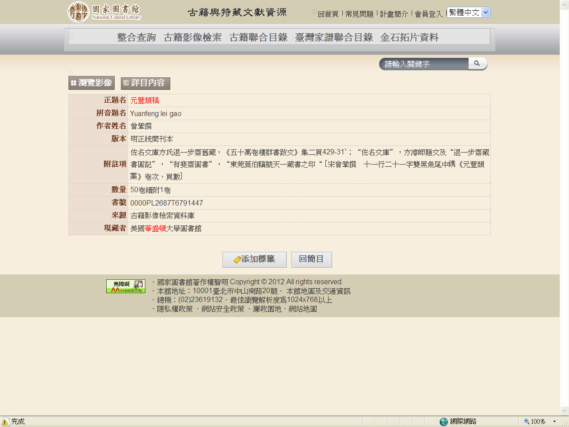
New Interface-Oldest Book at UW EAL

Slide 26
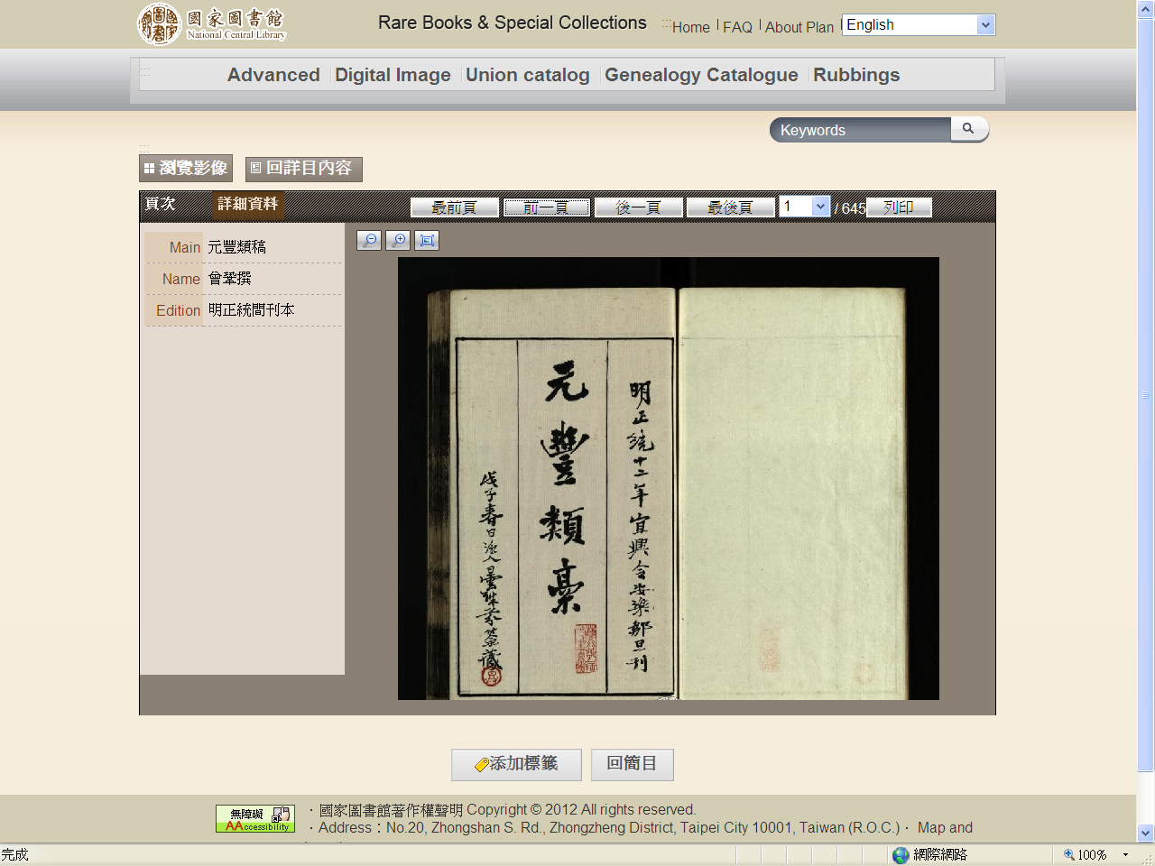
Browse the images: Oldest book at UW EAL

Slide 27
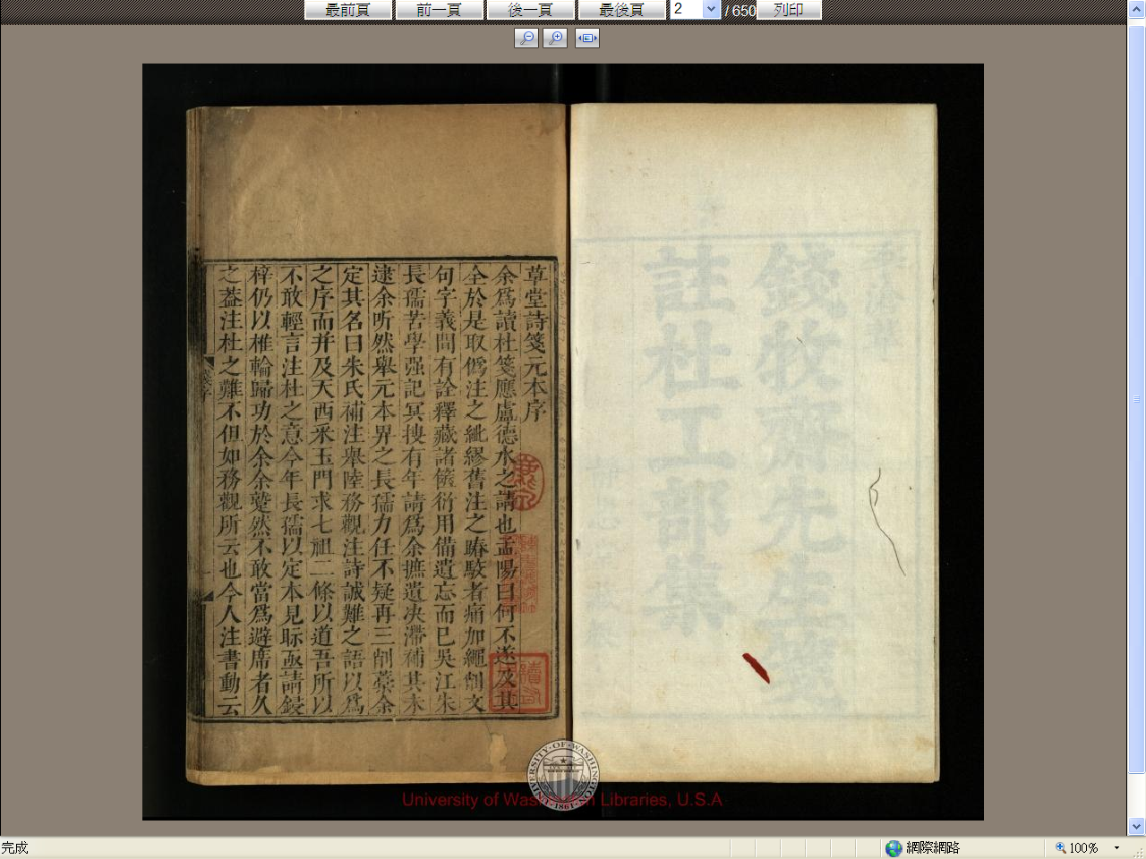
Qian Qianyi collection

Slide 28
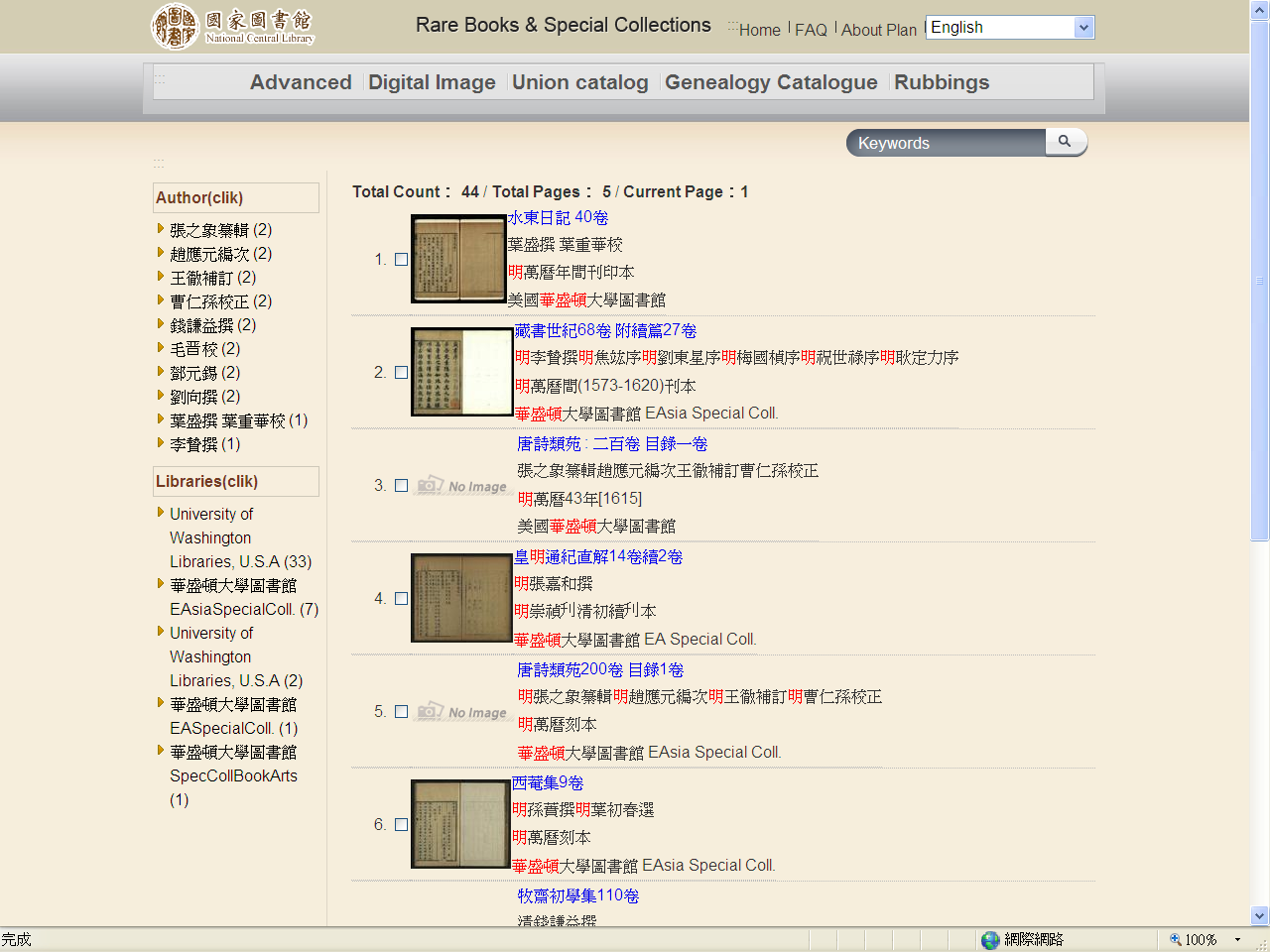
UW’s Ming edition

Slide 29
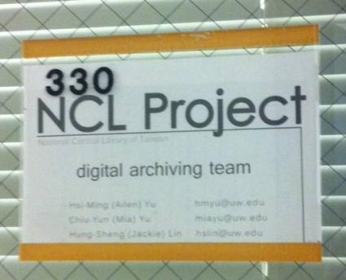
Issues and Impacts
Preservation urgency
Selection: rare vs old; unique to NCL vs UW preservation priorities
Continued funding needed – more rare books discovered during project
Incentive to eliminate cataloging backlog
Preservation projects
Exhibits & many displays for visits from potential donors and cultural experiences

Slide 30
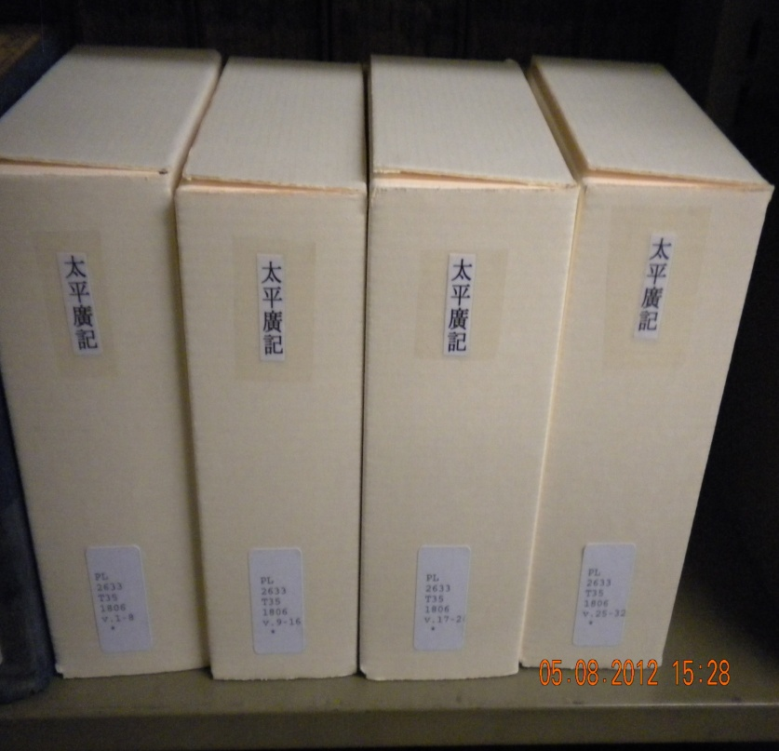
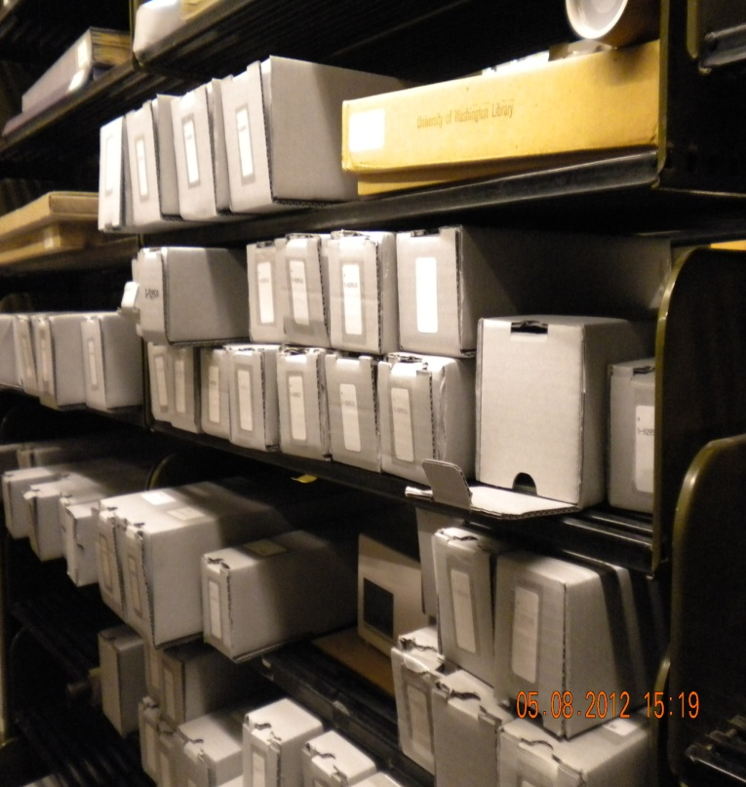
Preservation of special collection materials
Six internal grants of over $30,000 from Allen Endowment Fund and Friends of Libraries, and Jackson School provide preservation boxing to re-house EAL special collections of in CJK languages
Notes:
Take preservation for example:

Slide 31
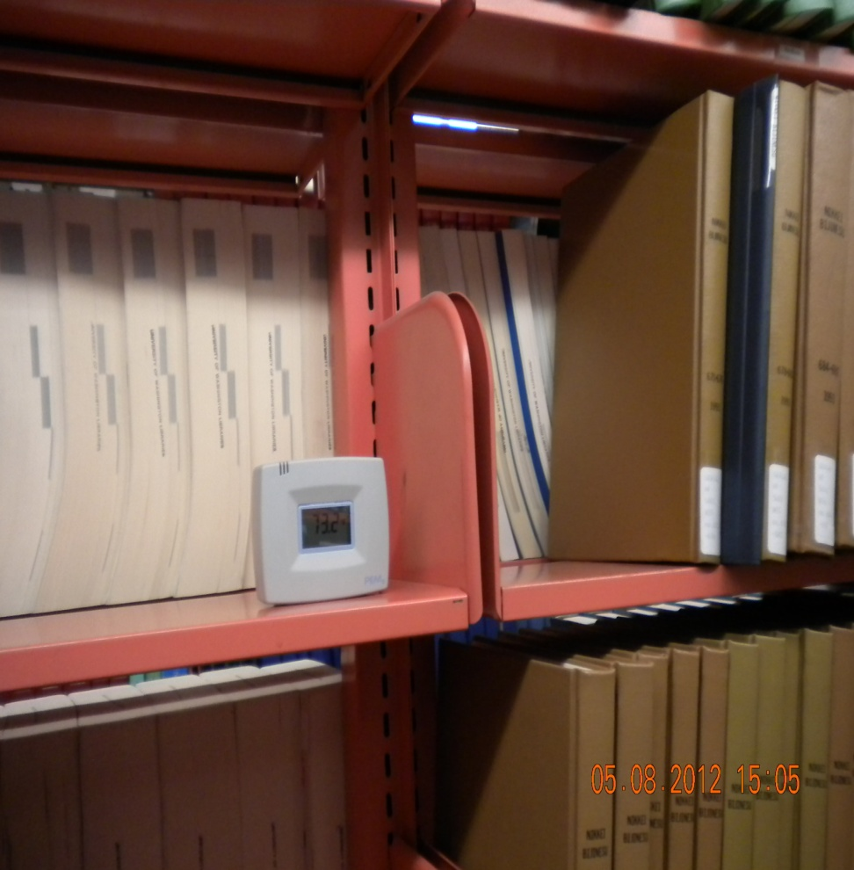
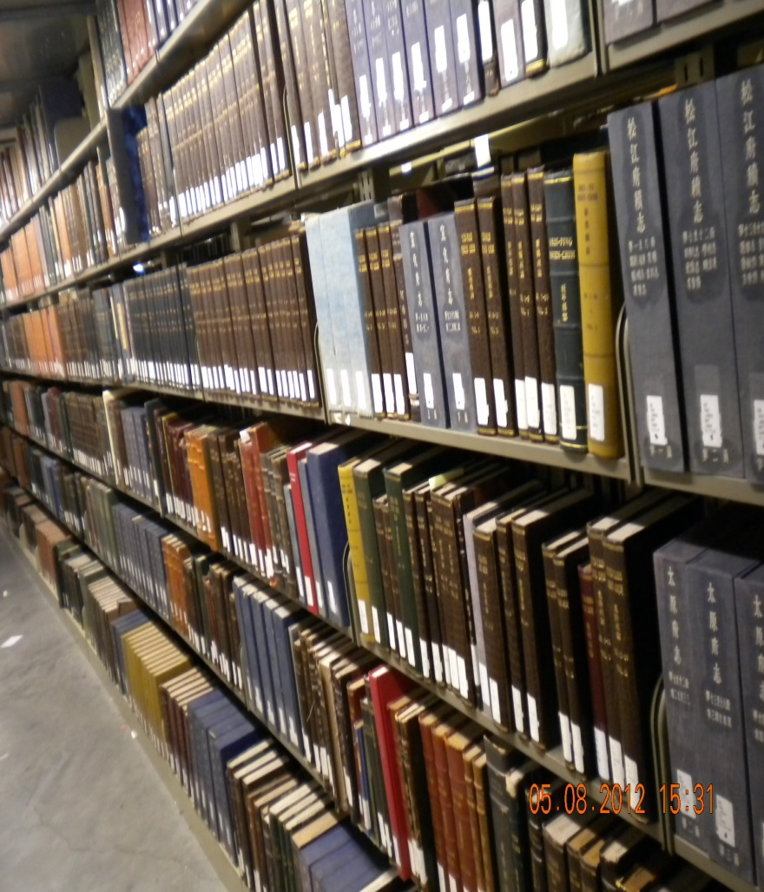
Improve storage environment: Moving into the new East Asia Library Special Collection Room

Slide 32
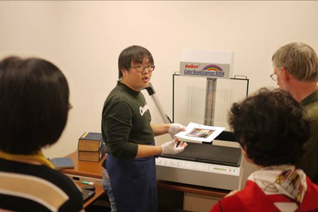
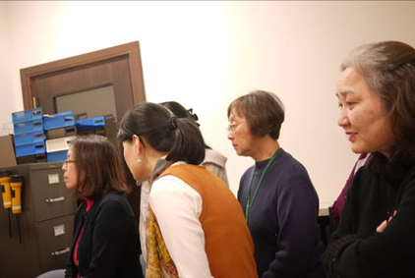
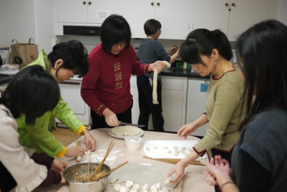

Great Cultural Experience for Staff
A mini lecture on rare book digitization
Making dumplings
for New Year party
Participate in staff meeting
Post with the Dean

Slide 33

Thank you!
谢谢！

